Slide 1


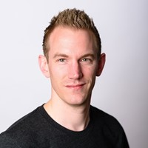




Speaker
Jaap Brasser
Azure Functions Unveiled
Jaap Brasser
jaap_brasser
September 16th & 17th
^{Online Event}
Powered By
International Conference

